Slide 1
Life Cycle of JSP
Prepared By,
Chirag K. Pujara

Slide 2
JSP Life Cycle
A Java Server Page life cycle is defined as the process that started with its creation which later translated to a servlet and afterward servlet lifecycle comes into play.
The process goes on until its destruction.

Slide 3
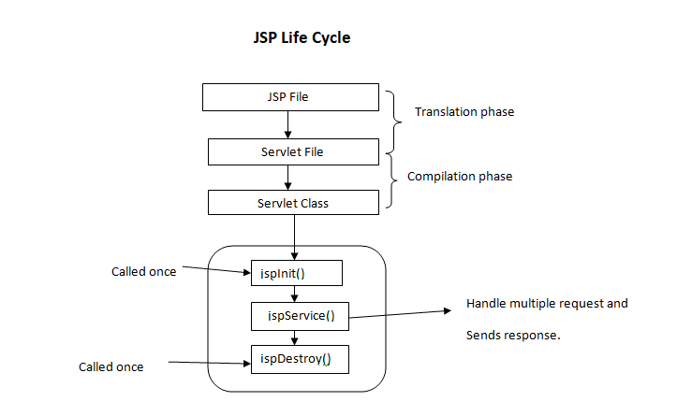
JSP Life Cycle

Slide 4
Steps of Life Cycle
Translation of JSP page to Servlet
Compilation of JSP page(Compilation of JSP into test.java)
Classloading (test.java to test.class)
Instantiation(Object of the generated Servlet is created)
Initialization(jspInit() method is invoked by the container)
Request processing(_jspService()is invoked by the container)
JSP Cleanup (jspDestroy() method is invoked by the container)

Slide 5
Steps of Life Cycle I
Translation of JSP page to Servlet :
This is the first step of the JSP life cycle.
This translation phase deals with the Syntactic correctness of JSP.
Here test.jsp file is translated to test.java.
Compilation of JSP page :
Here the generated java servlet file (test.java) is compiled to a class file (test.class).
Classloading :
Servlet class which has been loaded from the JSP source is now loaded into the container.

Slide 6
Steps of Life Cycle II
Instantiation :
Here an instance of the class is generated.
The container manages one or more instances by providing responses to requests.
Initialization :
jspInit() method is called only once during the life cycle immediately after the generation of Servlet instance from JSP.
This method can be overriden.

Slide 7
Steps of Life Cycle III
Request processing :
_jspService() method is used to serve the raised requests by JSP.
It takes request and response objects as parameters.
This method cannot be overridden.
JSP Cleanup :
In order to remove the JSP from the use by the container or to destroy the method for servlets jspDestroy()method is used.
This method is called once, if you need to perform any cleanup task like closing open files, releasing database connections.
jspDestroy() can be overridden.

Slide 8
IMP Questions
Explain life cycle of JSP [4 Marks]
List two methods of JSP life cycle which can be overridden. [2 Marks]

